Slide 1
Unit 6
Graph

Slide 2
Formal definition of graphs
A graph G is defined as follows:
G=(V,E)
V(G): a finite, nonempty set of vertices
E(G): a set of edges (pairs of vertices)
e=[u,v]
-endpoints
-adjacent nodes or neighbors

Slide 3
Terminology
Degree of a node u
deg(u)
Isolated node deg(u)=0
Path (P):
P=(Vo,V1,V2,…….,Vn)
Closed Path : Vo=Vn
Simple Path : all node are distinct

Slide 4
Terminology
Cycle
Connected Graph
Complete Graph: n(n-1)/2 edges
Tree
Labeled: w(e)
Multiple edges
Loops
Multigraph

Slide 5
Terminology
e1
e6
A
E
e2
e3
B
b
e4
C
D
e5
A
3
E
a
3
B
2
3
A
B
E
2
4
C
D
6
D
C
F
d
c

Slide 6
Directed Graph/ Digraph
Same as multi-graph except each edge in G is assigned a direction or
Each edge e is identified with an ordered pair (u,v) of nodes in G rather than an unordered pair [u,v]
Directed edge e=(u, v) also called arc
e begins at u and ends at v
u is the origin or initial point of e & v is the destination or terminal point of e
u is a predecessor of v and v is successor or neighbor of u
U is adjacent to v and v is adjacent to u

Slide 7
Terminologies
Outdegree of a node u in G,
outdegree(u), is the number of edges beginning at u.
Indegree of u,
indegree(u), is the number of edges ending at u.
A node u is called a source if it has a positive outdegree but o indegree.
A node u is called a sink if it has a zero outdegree but a positive indegree
Path, simple path and cycle are same as undirected graph but here direction is considered
A node v is said to be reachable from u if there is a (directed) path from u to v.

Slide 8
A directed graph G is said to be connected or strongly connected, if for each pair u , v of nodes in G there is a path from u to v and there is also path from v to u.
On the other hand G, is said to be unilaterally connected if for any pair u,v of nodes in G there is path from u to v or a path from v to u.

Slide 9
Parallel edges
Loop
P1 = (D, C, B, A) is path?
(C, B) is an edge?
P2= (D, B, A) is path?
Graph G is strongly connected?
Graph G is unilaterally connected?
Indeg(D)=?
Outdeg(D)=?
Sink node?
Source node?

Slide 10
Directed graph G is said to be simple if G has no parallel edges but may have loops but it cannot have more than one loop at a given node.

Slide 11
Sequential Representation of graphs
Adjacency matrix
Path matrix

Slide 12
Adjacency Matrix
Suppose G is a simple directed graph with m nodes and suppose the nodes of G have been ordered and are called V1, V2, ……., Vm.
Then the adjacency matrix A = (aij) of the graph G is the m x m matrix defined as follows
1 if vi is adjacent to vj that is if there is
an edge (vi, vj)
aij =
0 otherwise

Slide 14
Path Matrix
Let G be a simple directed graph with m nodes V1, V2, V3, …….. , Vm. The path matrix or reachability matrix of G is the m-square matrix P = (Pij) defined as follows:
1 if there is path from Vi to Vj
Pij =
0 otherwise

Slide 15
Linked Representation of Graph
Drawbacks of adjacency matrix
Difficult to insert and delete nodes in G
If no. of edges is equal to number of nodes, then the matrix A will contain many zeros. Hence a great deal of space will be wasted.

Slide 16
Linked Representation of Graph
Node list
Edge list

Slide 17
Linked Representation of Graph
Node list
Each element correspond to a node in G.
Node – name or key value
Next – pointer to the next node
ADJ – pointer to the first element in the adjacency list
NODE | NEXT | ADJ

Slide 18
Linked Representation of Graph
Edge list
Each element correspond to an edge of G.
DEST – point to the location in the list NODE of the destination or terminal node of the edge.
LINK – will link together the edges with the same initial node, that is, the nodes in the same adjacency list.
DEST | Link

Slide 19
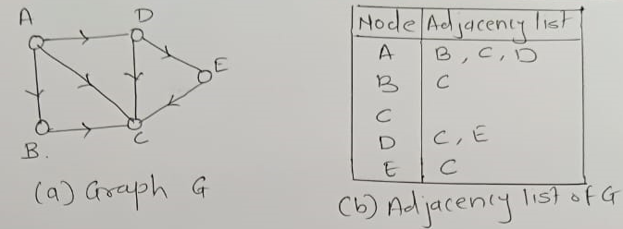
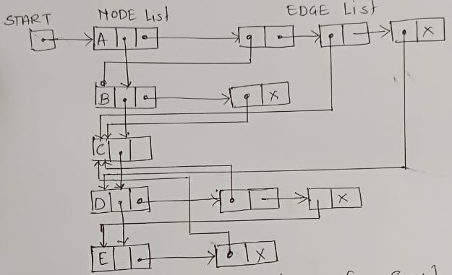
Linked Representation of Graph

Slide 20
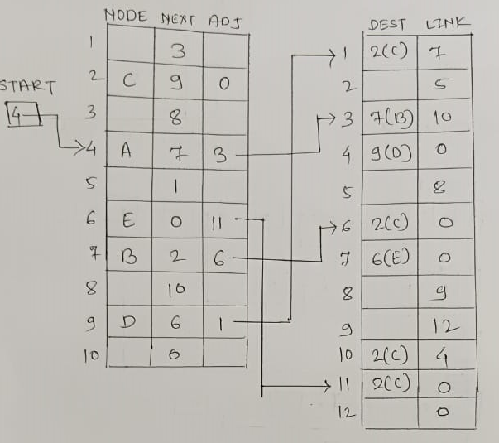
Memory Representation of Graph

Slide 21
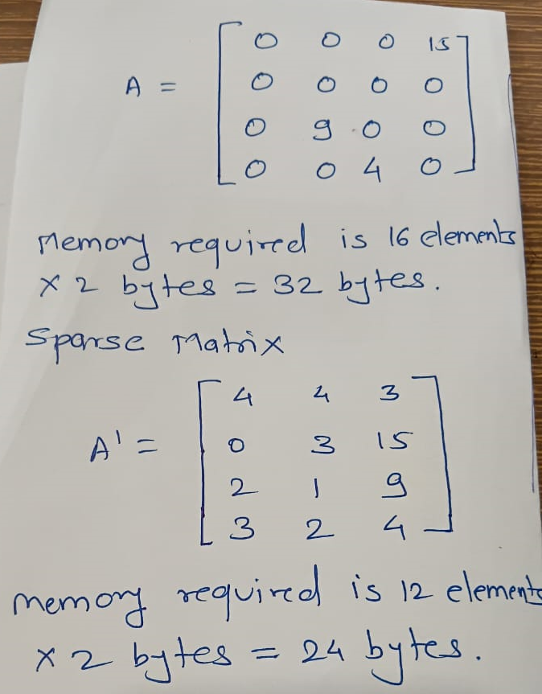
Sparse Matrix

Slide 22
Linked representation of Sparse matrix
Row header
Column header
Special header
Next Row | Row no. | Elements of the row
Element in the column | Column no. | Next column
Next element in the column | Row no | Col no | Value | Next element in the row

Slide 23
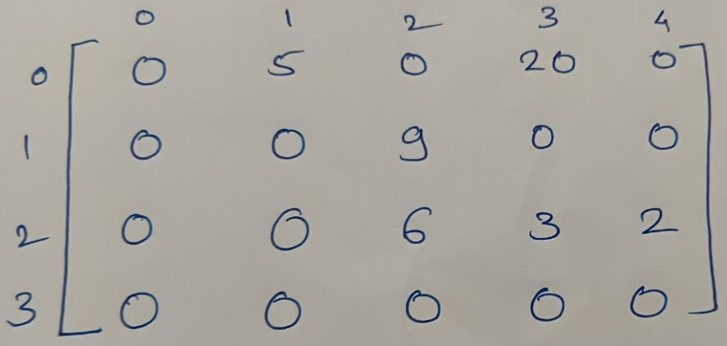
Example

Slide 24
Traversing a Graph
Examine the nodes and edges of a graph G
Two standard ways
Breath-First Search (BFS) – use queue
Depth-First Search (DFS) – use stack
During the execution of our algorithms, each node N of
will be in one of three states, called the status of N, as
follows:
STATUS = 1: (Ready state) The initial state of the node N
STATUS = 2: (Waiting State). The node N is on the queue or
stack, waiting to be processed
STATUS = 3: (Processed state) The node N has been
processed

Slide 25
Breath-First Search (BFS)
Begin at starting node A
First examine the starting node A
Then examine all the neighbors of A.
The examine all the neighbors of the neighbors of A and so on.
Need to guarantee that no node is processed more than once.
This is accomplished by using a queue to hold nodes that are waiting to be processed and by suing STATUS which tells us the current status of any node.

Slide 26
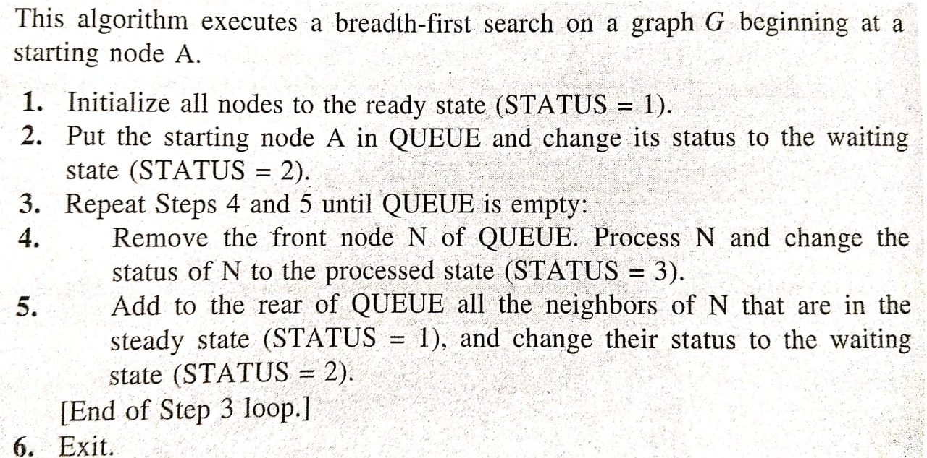
Algorithm

Slide 27
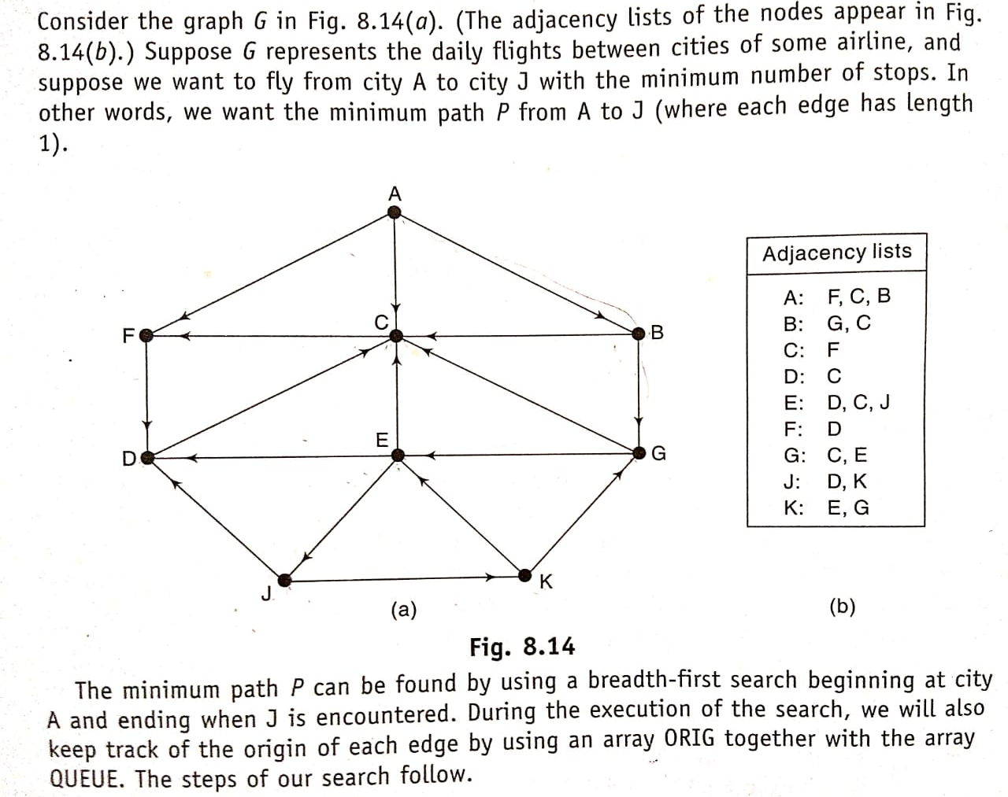

Slide 28
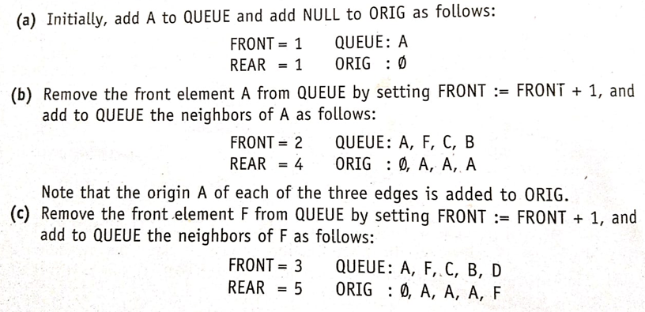

Slide 29
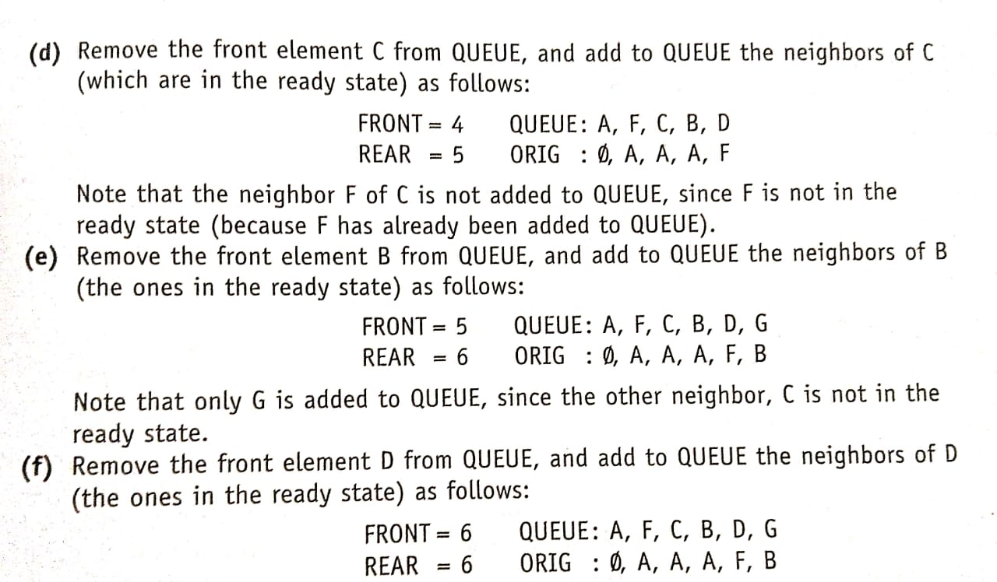

Slide 30
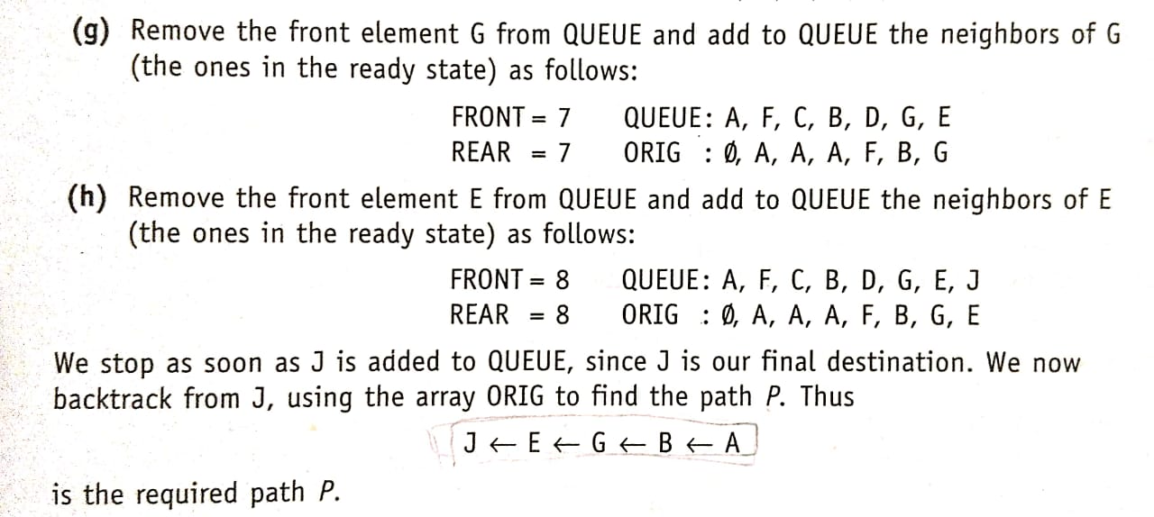

Slide 31
Depth-First Search (DFS)
Begin at starting node A
First examine the starting node A
Then we examine each node N along a path P which begins at A that is process a neighbor of A, then a neighbor of neighbor of A and so on.
After coming to dead end, backtrack on P until we can continue along the another path P’ and so on.
Use stack

Slide 32
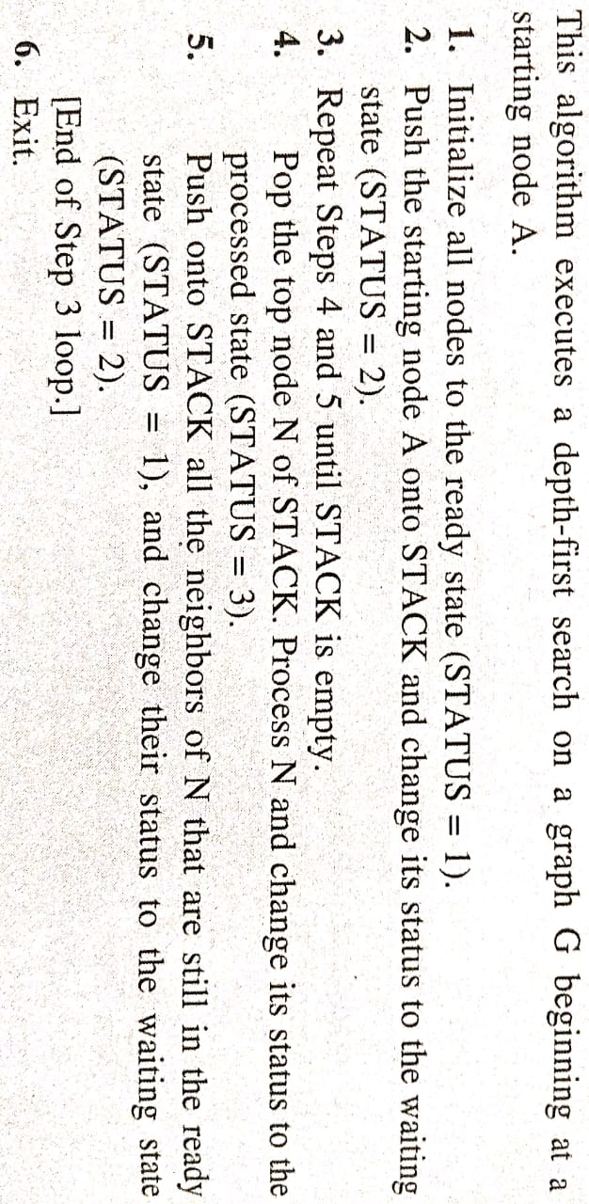
Algorithm

Slide 33
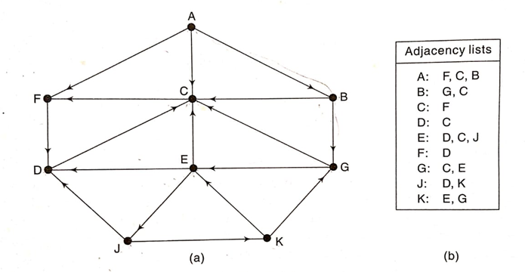
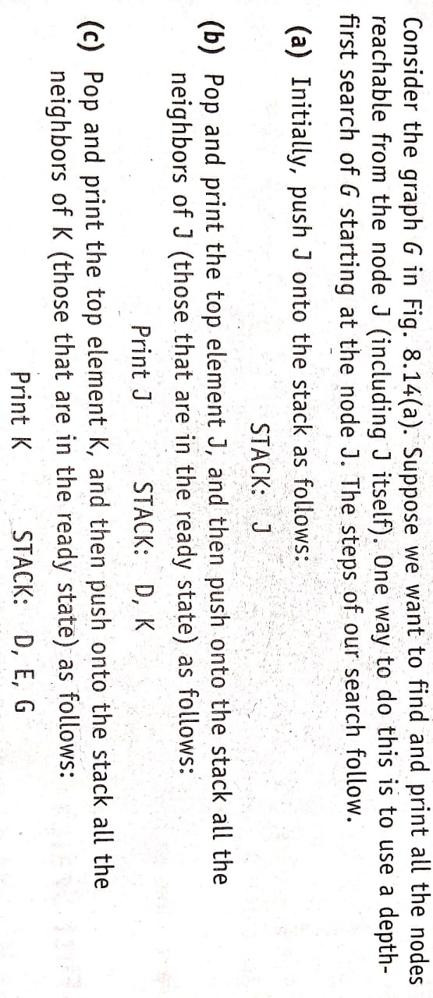

Slide 35
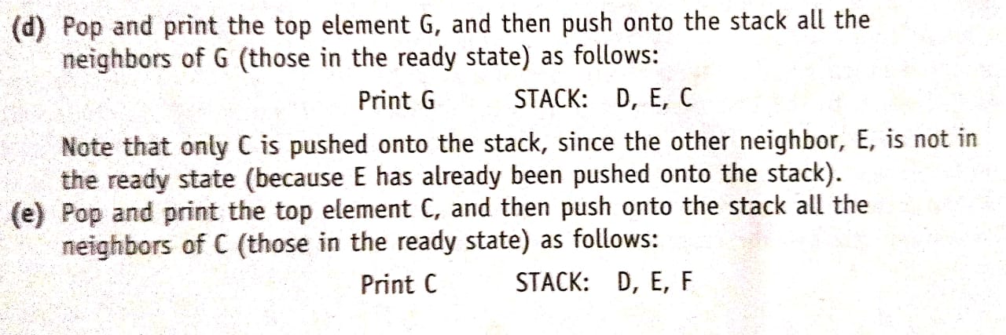

Slide 36
